Slide 1
Code Quality & Security Workstream Update PI-18 Workstream Feedback Session – 27 April 2022 Presenters Godfrey Kutumela Support Members : Aime Bukasa, Kim Walters, Victor Akidiva, Pedro Barreto, Michael Richards, Simeon Oriko, Miguel de Barros, Sam Kummary, Lewis & Tom Daly

Slide 2
Workstream Overview
Objective:
Continuously improve the Trust (reliability, transparency, privacy, compliance, quality and security) of the Mojaloop Platform and transform our approach to quality and security in line with L1P principle on data privacy and emerging technological trends.
Delivery Model:
Supports both functional and non-functional requirements of the project, working alongside with other workstreams & various governance committees on a shared responsibility Model.
Approach:
Standards and Control Centric – Define and maintain Mojaloop software quality and security standards and guidelines – In certain areas we provide reference implementation whereas for other areas we require certain policies or standards to be adhered to.
Risk Centric – Perform risk assessments and threat modelling to identify, validate, classify & prioritize security requirements.
Milestones:
PI 1 – 8 : Foundation Phase - Built-in confidentiality and Integrity as part of the Core Mojaloop Architecture.
Developed and Implemented Signatures, MTLS, PKI, encryption standards
Established a code quality and security framework - DevOps & CI/CD Tools automation, workflows & policies
PI 9 – Current: Phase 5 (One Loop for all) – Consolidate, optimize & improve.
Baselining Mojaloop against best practice standards – PCI DSS, ISO27001 and GDPR
Embed Security into the reference architecture, new functionality additions and DevOps processes
Maintain and enhance DevSecOps processes

Slide 3
PI 18 Objectives
Fraud and risk management system (FRMS) security review and validation
Vulnerability management and DevSecOps process/tool enhancements
Perform a quarterly open-source software (OSS) scan
Open-Source License Assessment - To ensure compliance with Mojaloop open-source license policy
Open-Source Security Assessment - To ensure that libraries used are not vulnerable and outdated to minimize security risks

Slide 4
FRMS security implementation review and validation
Objective - Review and validate security implementation on all new major functionality additions to ensure alignment with mojaloop security standards and policies.
Completed to date – PI 18:
Reviewed and validated FRMS security designs and implementation
Performed an OSS scan and remediated all high findings

Slide 5
FRMS security implementation review and validation
Core security controls built into the current Beta version
- The focus was on what needs to be natively supported by the platform out of the box

Slide 6
FRMS OSS scan results overview
Codebase size
42 repositories with 593 unique libraries
Upon Analysis:
No library was flagged with a very-high or high-risk license
All libraries with high security vulnerable have a fix available via an upgrade.
Version Management Status:
Out of 593 libraries
568 are up to date
25 libraries are outdated

Slide 7
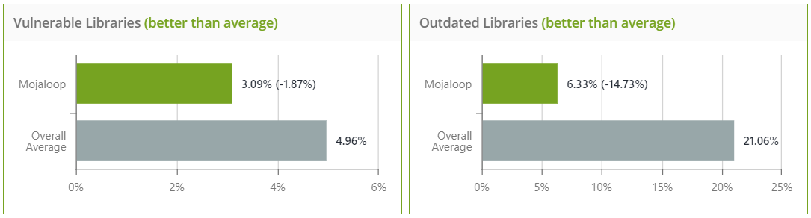
Quarterly OSS Overview
All Mojaloop repos were included in the scan
The scan was performed on 104 codebases with 7055 unique libraries
!
18 January 2022 | 18 April 2022
104 Codebases with 7055 libraries 6625 libraries are up to date – Excellent version management 430 libraries are outdated and should be reviewed for upgrades 130 libraries with multiple version and should be upgraded to the most updated version. | 111 Codebases with 7729 libraries 7729 7221 libraries are up to date – Excellent version management 489 libraries are outdated and should be reviewed for upgrades 165 libraries with multiple version and should be upgraded to the most updated version.
According to WhiteSource Benchmark database, Mojaloop is better than average in vulnerable libraries and in outdated libraries, potentially indicating that Mojaloop have an effective security vulnerability scanning capability and version management controls.

Slide 8
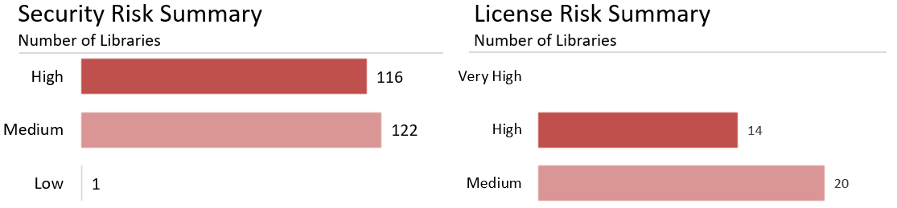
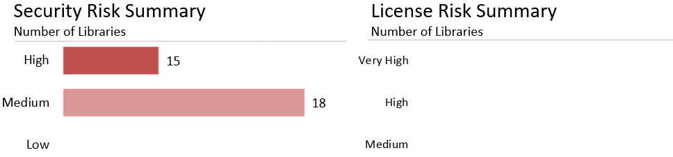
Findings Overview
18 January 2022
18 April 2022

Slide 9
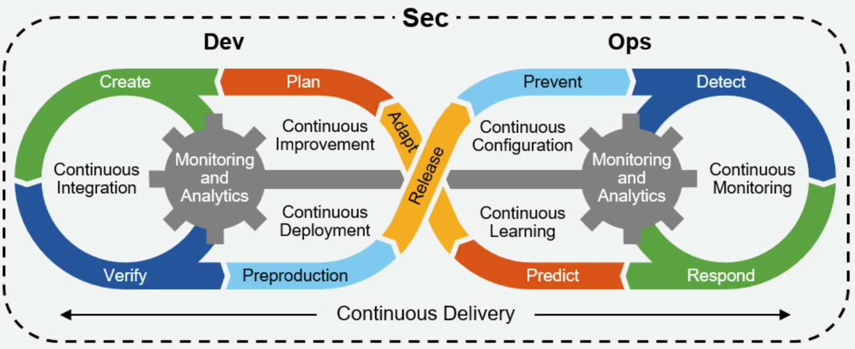
Vulnerability management and DevSecOps process/tool enhancements
On going maintenance and enhancements of the DevSecOps processes, policies and tools and policies.
On going support Activities:
1. Regular Security Patches + Updates
Addressing regular Dependabot and Snyk security alerts
Running `npm audit` on flagged repos
Improving CI/CD Workflows and adding new policies as needed
Partial implementation of automated releases
2. Performed an independent OSS scan once a quarter - #2750
3. Developed a Node version upgrade strategy – DA issue #78
4. Developed a draft framework for code security standard - #2722
5. Developed code integrity assurance solution – Helm charts signing - #2634
6. Exploring with Code Secret Scanning(#2737) and CodeQL (SAST) - #2738
Planned Enhancements for PI 19
Approve the code security standard
Implement the code integrity assurance solution on helm charts
Implement Github secret scanning and Code QL SAST - as per approved code security standard
Document the improved DevSecOps framework for implementors to adopt

Slide 10
Thank you Questions and comments
muchas gracias

